Slide 1
URP Exchange: March 2026
Undergraduate Research Annual Reports and Data Gathering
Dr. David Salomon, Christopher Newport University
Dr. Amy Childress, Purdue University
Dr. Natalia Toro, University of Central Florida

Slide 2
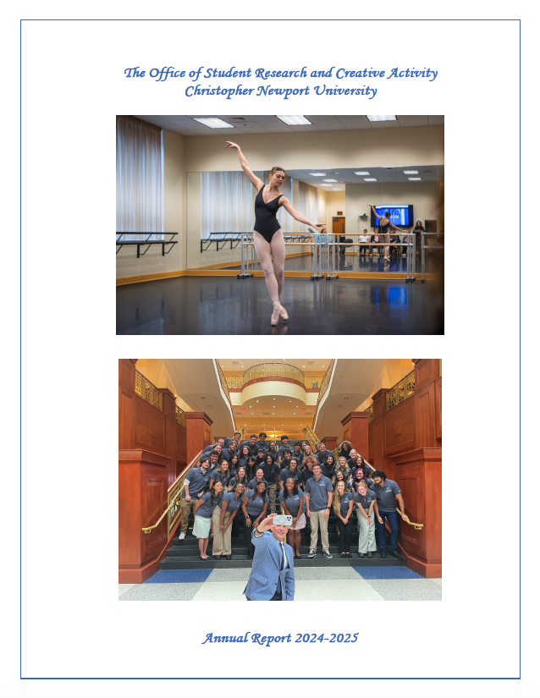

Slide 3
Uses
Administration
Faculty Engagement
Advocacy and Funding Requests
  Advancement/Donors
External Partners
Marketing and Recruitment
Program Assessment

Slide 4


Issues in Reporting about UR
Misconceptions about what is (and is not) undergraduate research
Broad use of “research” and impacts of its use on:
  Inclusion|exclusion of experiences
  Inconsistencies
Inaccurate reporting:
  Misinterpretations
  Incomplete datasets
  Underreporting
  Double-counting (use unique student counting)
Categories/types of research and impacts of their use on:
  Inclusion|exclusion of experiences
  Inconsistencies; not comprehensive
Is reporting done alone, or is reporting integrated with your assessment, evaluation, or research (AER)?
…2,000 research projects completed every year.
Unknown
Notes:
CRAIG: {Present} Referring back to the 2023 ConnectUR presentation from Amy and Craig about UR definitions.
The reporting foundations we now use at Purdue started around 2019.
Other issues (shown here) appeared as we discussed terms and definitions. We did not track counts of each issue but noticed themes.
Reappearance of these themes kept occurring; this was evidence of the need for definitions and to support accurate reporting.
The shared resources include a worksheet. Part 1 helps you identify your own issues.
AMY: {Present} For an example of institutional inconsistency, "2000" published in multiple places without a source and we could not validate it between 2017 (OUR founded) and 2022. As of this AY, we are past 4000 students tracked with at least one URE within the AY.

Slide 5
Big Ten Academic Alliance (BTAA) Collaboration
Historical perspective
Key initiatives:
  Annual meetings at a host institution & ConnectUR
  Annual survey
  On-going workshops
  Shared drive & conversations

Slide 6
Institutional Reporting
Targeted Expectations (besides the key metrics): | How We Meet Expectations:
Leadership: Longitudinal impacts of specific experiences. Specific reporting to accommodate transitions. Evidence of students’ work. “On demand” availability. “Value add” to campus Faculty: Evidence of UR outcomes. Specific impacts of UR on faculty research. Lists (students, projects, presentations, publications) for P&T. Recognition. Students: How they compare to peer students. Donors: Stories tied to particular interests. | Data Collection: Identifiable tracking of UR engagements. Sharing agreements with campus partners. Specific data collection for targeted research questions. Nimble/responsive to just-in-time requests. Academic consortium (i.e., BTAA) survey Institutional Reporting Methods: Briefs, Dashboards, Annual reports, and Sharable datasets.
Notes:
AMY: {Present}
Targeted expectations:
The key metrics are the most common reporting sought from us. On the left are additional expectations from stakeholders; anticipating these better prepares us to meeting the expectations.
How we meet:
On the right are our most common strategies for institutional reporting.
CRAIG: {Present} How we meet:
Not enough time to go through all the data sources and fields in these sources.
Overall, the goal is to create/maintain robust datasets that allow us to be nimble/responsive to JIT request. (For ex, “how many URs are STEM students?)
Shared resources include a worksheet. Parts 3/4 helps you identify data sources, and includes a list of the fields common across all our data sources, tracking experiences, students, and mentors.

Slide 7
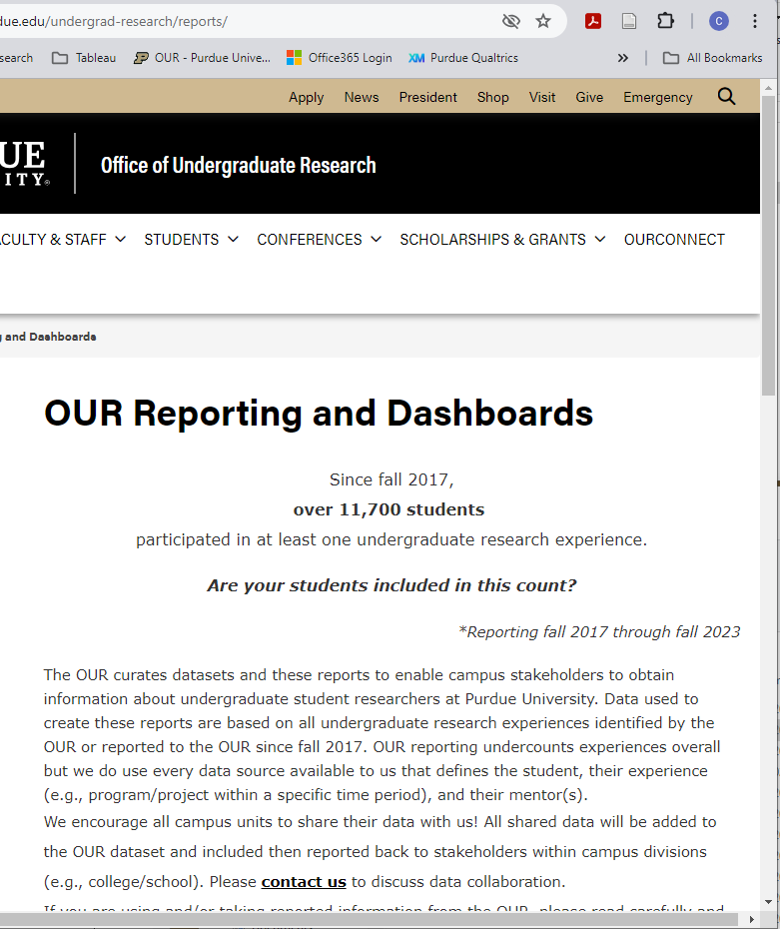
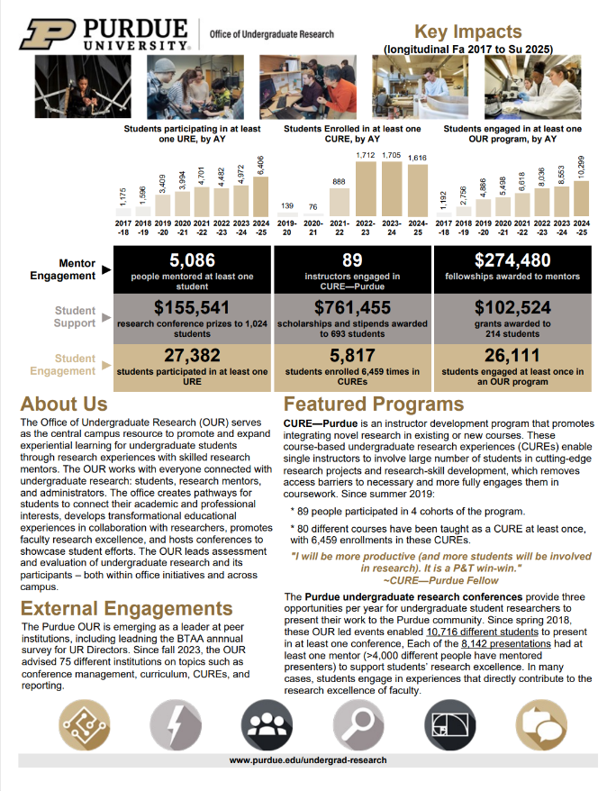
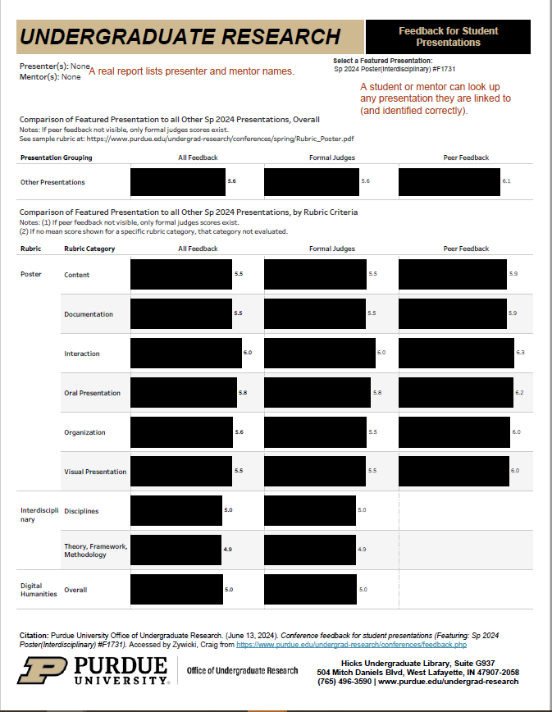
Reporting Samples
Website | “At a Glance” Brief | Dashboard
Source: https://www.purdue.edu/undergrad-research/about/reporting/index.php
CUR Presentations: https://www.purdue.edu/undergrad-research/CUR/
Notes:
AMY: {Present}
Transition to Craig.
CRAIG: {Present}
Go to Reporting website. Share samples, including reference back to what is available in OneDrive.

Slide 8
Take Aways & Recommendations
Take Away | Recommendation
Determine challenges and limitations of reporting. | Adapt the presented issues to your institution and determine solutions.
Identify core purposes and key questions for reporting on URs. | Revise the presented metrics to meet your needs. Identify existing baselines and goals. Strategize changes for future reporting.
Expose the essential UR data fields, how they are collected, and how they are used in institutional/program reporting. | Adapt your present data collection/management to reporting needs. Integrate data collection into program activities. Maximize use of existing institutional data.
Connect with peer units/programs with benchmarking needs. | Identify your peer network. Discuss common needs and how to gather/share information.
Notes:
CRAIG:
{Present} what we take from these results, how we have (or might still) change.
{Discussion} Start Q/A here, then transition to next slide.

Slide 9
Counting Undergraduate Research
University of Central Florida
Natalia Leal Toro
University of Central Florida
our@ucf.edu

Slide 10

University of Central Florida Overview
Public University | Orlando, Florida
  2025 Research Activity Designation:
  Research 1: Very High Spending and Doctorate Production
UCF is the largest university by enrollment in Florida: 60,070 Undergraduates (Fall 2025)
  Transfer Students: 37%
  First Generation: 27%
  Pell Eligible: 37%
UCF has full-time faculty to student ratio is 29:1, the highest ratio in the Florida State University System
  78% 6-year graduation rate

Slide 11
Questions Many of Us Have
How many documented students are involved with undergraduate research at UCF? Growth or Decline?
What are the demographics of the students who are involved in UR?
How does undergraduate research participation correlate with:
Retention
Graduation
GPA
Post-Graduation Goals

Slide 12
Methods of Collecting Data
Program Level Data (we collect through our programs)
University Survey Data (Operational Excellence and Academic Support)
  Entering Student Survey/Voice of the Knight
  Graduating Student Survey
    Florida State University System requests data on UR involvement annually
    Questions based on Florida BOG guidance to Florida SUS institutions
    First Destination Survey (graduate school/employment outcomes before graduation)
Institutional Data UR Dashboard (Analytics and Integrated Planning)
  Work with our university analytics office to attempt to count every UCF student who conducts any documented undergraduate research with a UCF faculty mentor (focus on independent research vs. Research Intensive courses)

Slide 13
Undergraduate Research Data Dashboard
Creation and History
Begun in 2009- Partnership with our institutional data and analytics office (Schneider et al. 2016, Schneider et. al 2021)
Maintained by OUR annually in partnership with UCF’s data and analytics office
  Collect centralized course data and funding data
  Ask other units on campus for data on their UR programs
  Create a spreadsheet
    Loaded into the university’s PeopleSoft organizational management system

Slide 14
What counts towards the dashboard?
Commitment: cross-campus data gathering and submission (Summer)
Paid Experiences
Grant Funded (OR)
Funded Through OUR (ex. SURF)
*seeking to track FWS
Structured Programs
F-LEARN
McNair Scholars Program
EXCEL Research
LSAMP
Others
Academic Credit
Honors Undergraduate Thesis
Directed Independent Research***
Research Intensive (Different Dashboard)
Student Scholar Symposium

Slide 15
Undergraduate Research Data Dashboard
Limitations
UCF is an unusually large (and growing) institution
Dashboard can only include:
  students with a UCF ID
  mentors with a UCF ID
    Leaves out external access initiatives (NSF Research Experiences for Undergraduates, etc)
  Formally recorded experiences (course credit, program participation)
    Lab volunteers and others may not be included
Year Start | Year End | Student ID | Faculty ID | Term | Program Code
2024 | 2025 | 7654321 | 1234567 | 1820 | DIR
2024 | 2025 | 7654321 | 1234567 | 1830 | GRANT-OUR
2024 | 2025 | 7654321 | 1234567 | 1830 | SSS-OUR
2024 | 2025 | 0101010 | 6543210 | 1830 | SSS-OUR
2024 | 2025 | 0101010 | 6543210 | 1820 | HUT-BHC
2024 | 2025 | 0101010 | 6543210 | 1830 | HUT-BHC

Slide 16
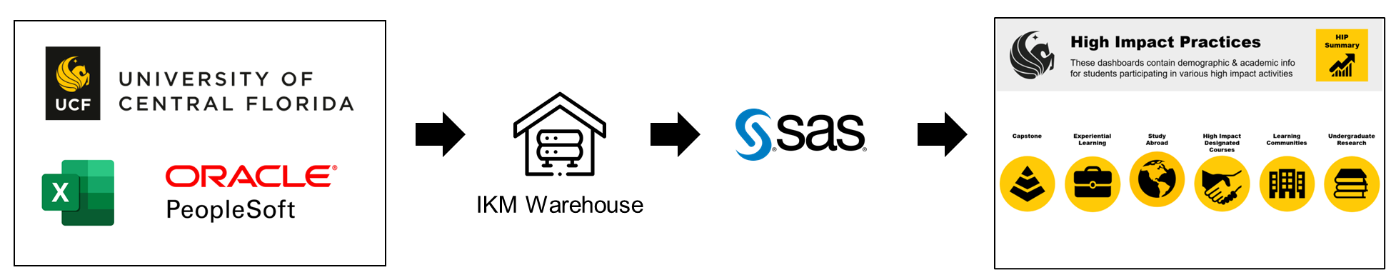
Undergraduate Research Data Dashboard
Data Sources and Institutional Collaboration
  Data sources: PeopleSoft, warehouse tables, UR data collected
  Tables are created from various data sources and stored in the IKM warehouse
  Dashboards are created using SAS Visual Analytics
  Updated various timelines; some each term, some annually

Slide 17
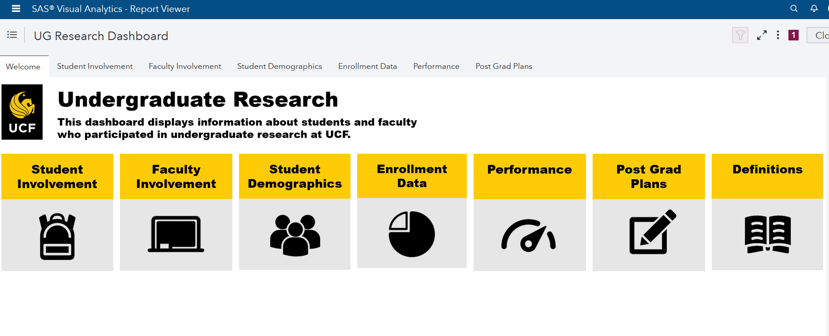
Undergraduate Research Data Dashboard
Current Contents
Course Credit
Directed Independent Research (--4912 courses)
Honors Undergraduate Thesis- Burnett Honors College
Funding
Undergraduate Research Assistants paid by external grants
Federal Work Study (one time)
OUR Programs
Research and Travel Grants
Travel Awards
Student Scholar Symposium
Summer Undergraduate Research Fellowship
Research-Centered Learning Communities (McNair, etc.)

Slide 18
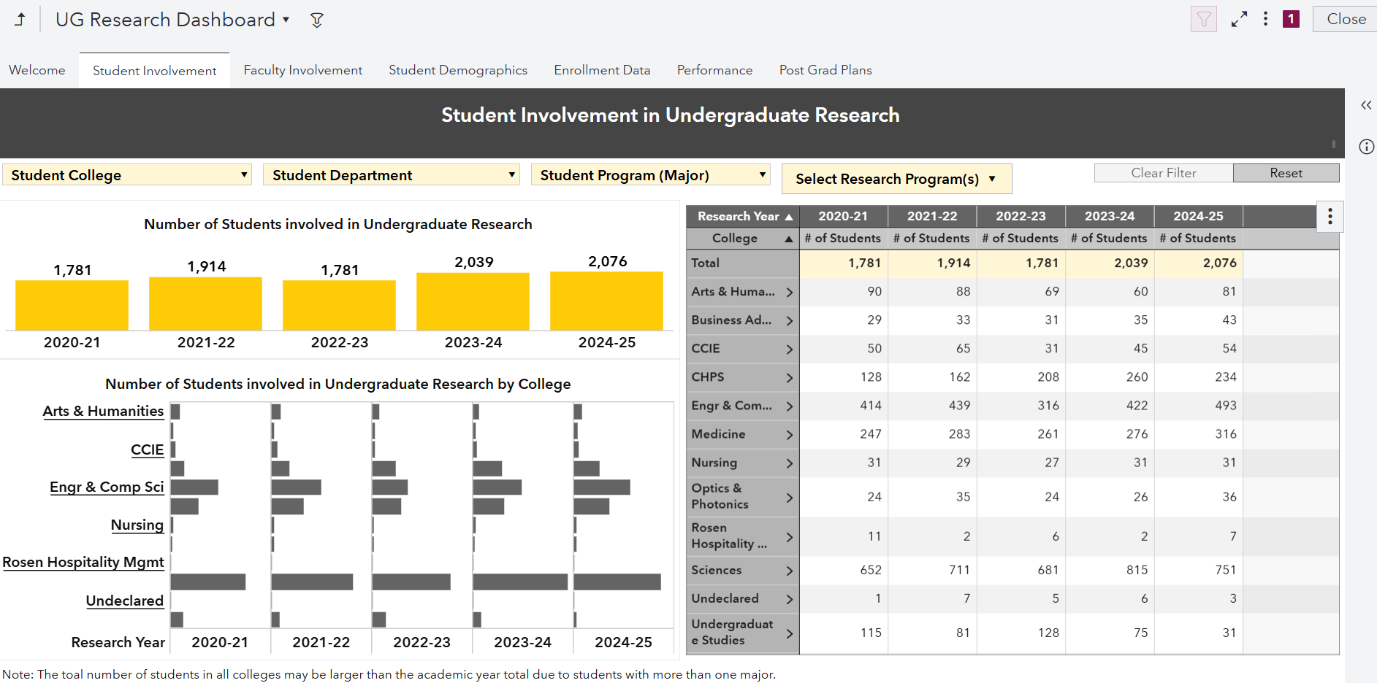
Research: Dashboard Snapshot

Slide 19
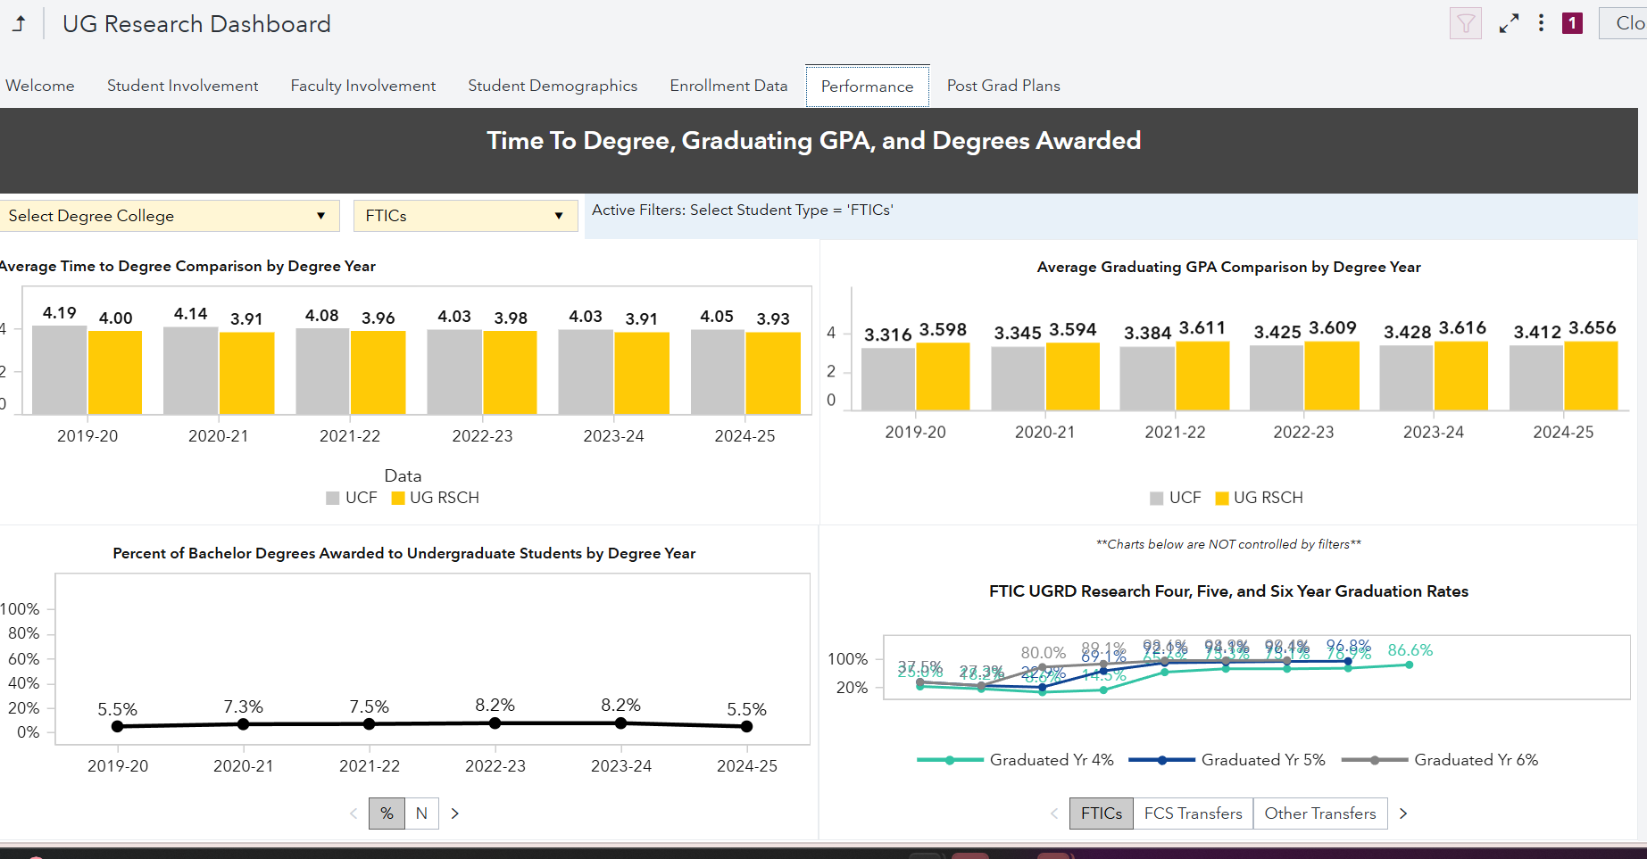

Slide 20
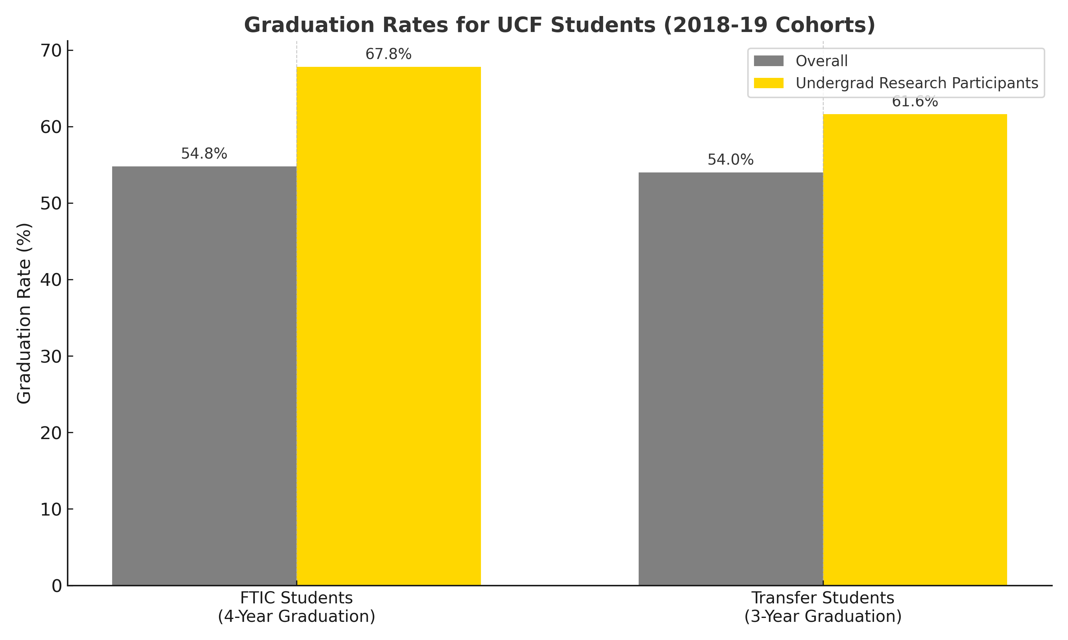
Higher Graduation Rates
Research: Dashboard Board Uses
67.8% of FTIC students (2018-2019 cohort) who participated in undergraduate research graduated in 4 years vs. 54.8% of overall UCF FTIC students in that cohort.
61.6% of Transfer Students (FCS AA 2018-19 cohort) who participated in undergraduate research graduated in 3 years vs. 54% of overall UCF Transfer Students in that cohort.

Slide 21
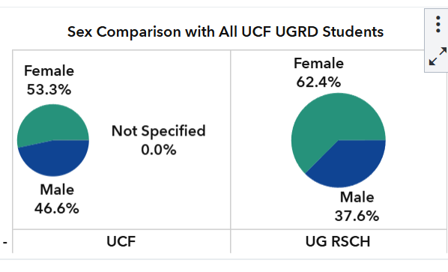
Research: Dashboard Board Uses
Exploring and Addressing
Gaps

Slide 22
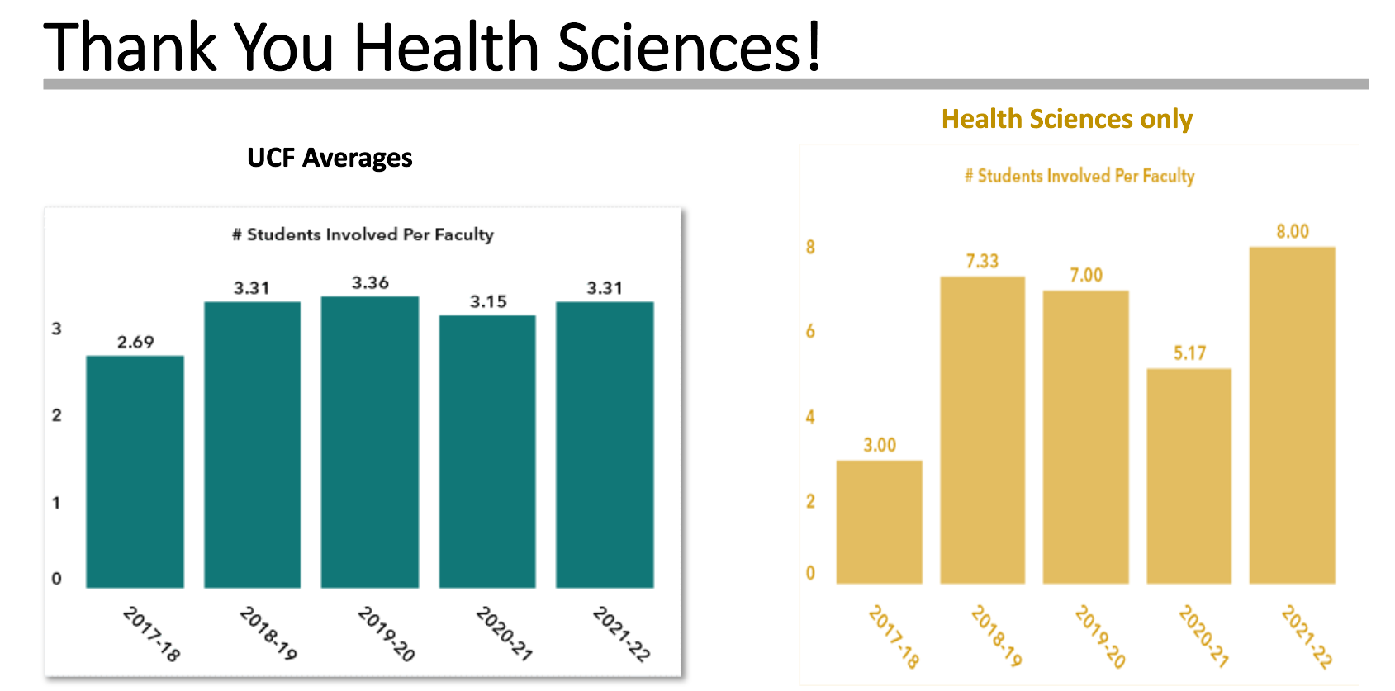
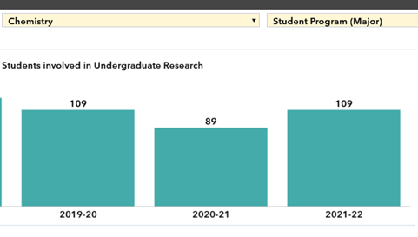
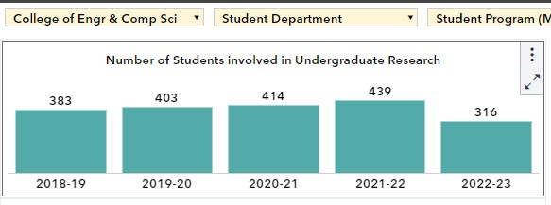
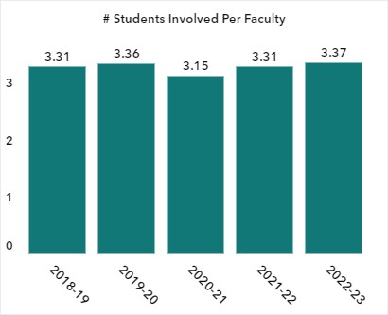
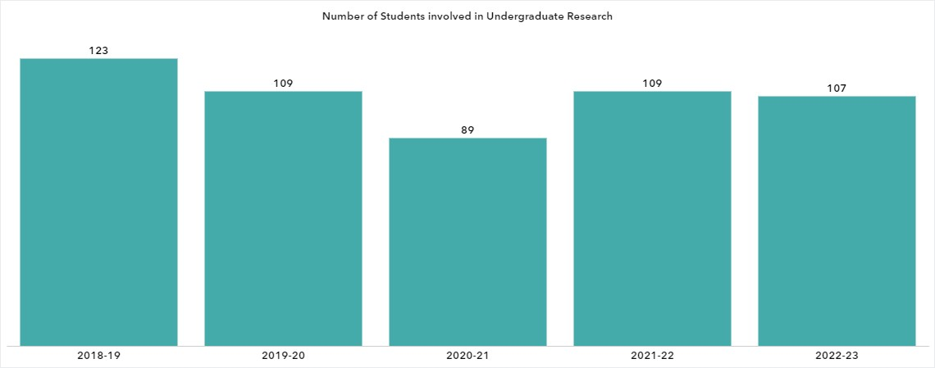
Research: Dashboard Board Uses
Highlighting Departments' UR efforts
Pandemic Impact by Discipline
Sudden Drop in Involvement

Slide 23
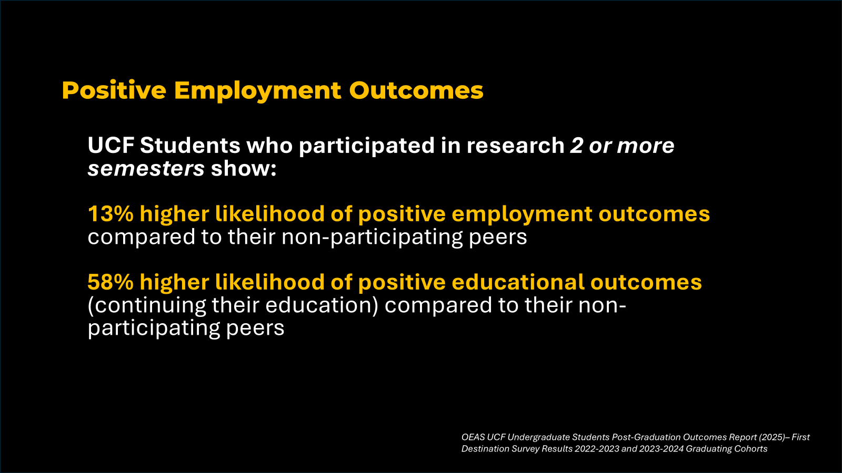
Research: Dashboard Board Uses
Working with Survey Data (Like First Destination Survey) to dig into key questions

Slide 24
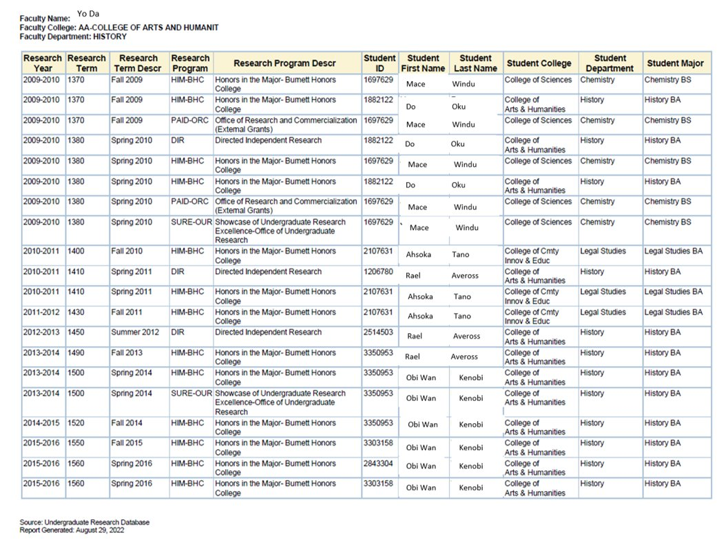
Research: Dashboard Board Uses
Faculty Reports

Slide 25
Other Uses of Dashboard Data
Reaching out to departments/colleges to partner or grow UR (100% HIP’s by 2027)
Board of Governor’s Asks
Campus Wide Grants (Dashboards can be accessed by all faculty/staff)

Slide 26
Resources:
Schneider, K., Kuperman, A., Watts, A., Barulich, D., Campbell, T. (2021) .Tracking and Assessing Undergraduate Research Campus-Wide: Demographics, Academic Success, and Postgraduation Plans. Journal of the Scholarship of Teaching and Learning, Vol. 21, No. 1, April 2021, pp. 107-119.
Schneider, K., Sullivan, L., & Collado, E. (2016). A Centralized Undergraduate Research Database: Collaboration Between Institutional Research and University-wide Research Programs. Council on Undergraduate Research Quarterly. 36. 10.18833/curq/36/4/6. A Centralized Undergraduate Research Database: Collaboration Between Institutional Research and University-wide Research Programs.

